Slide 1
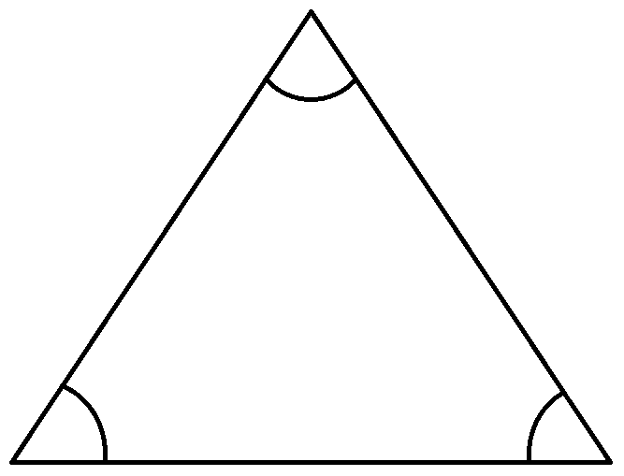
Daily Review
$$a+b+c=180\text{o}$$
$$70\text{o}$$
$$c=180−a−b$$
$$c=180−70−60$$
$$=110−60$$
$$60\text{o}$$
$$c$$
$$=50\text{o}$$

Slide 2
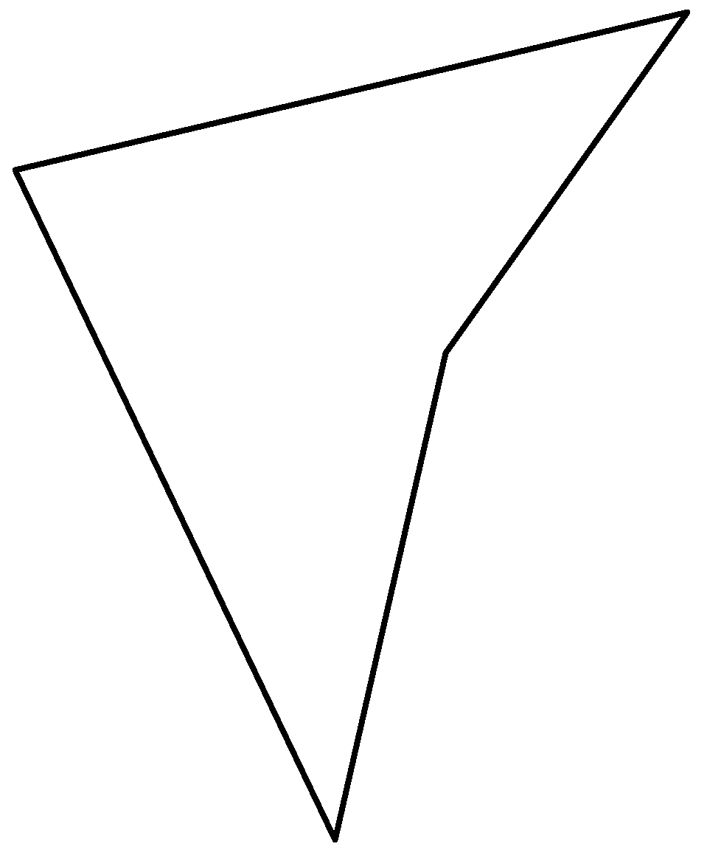
Daily Review
$$a+b+c+d=360\text{o}$$
$$45\text{o}$$
$$d$$
$$d=360−a−b−c$$
$$220\text{o}$$
$$d=360−45−220−40$$
$$=315−220−40$$
$$40\text{o}$$
$$=95−40$$
$$=55\text{o}$$

Slide 3
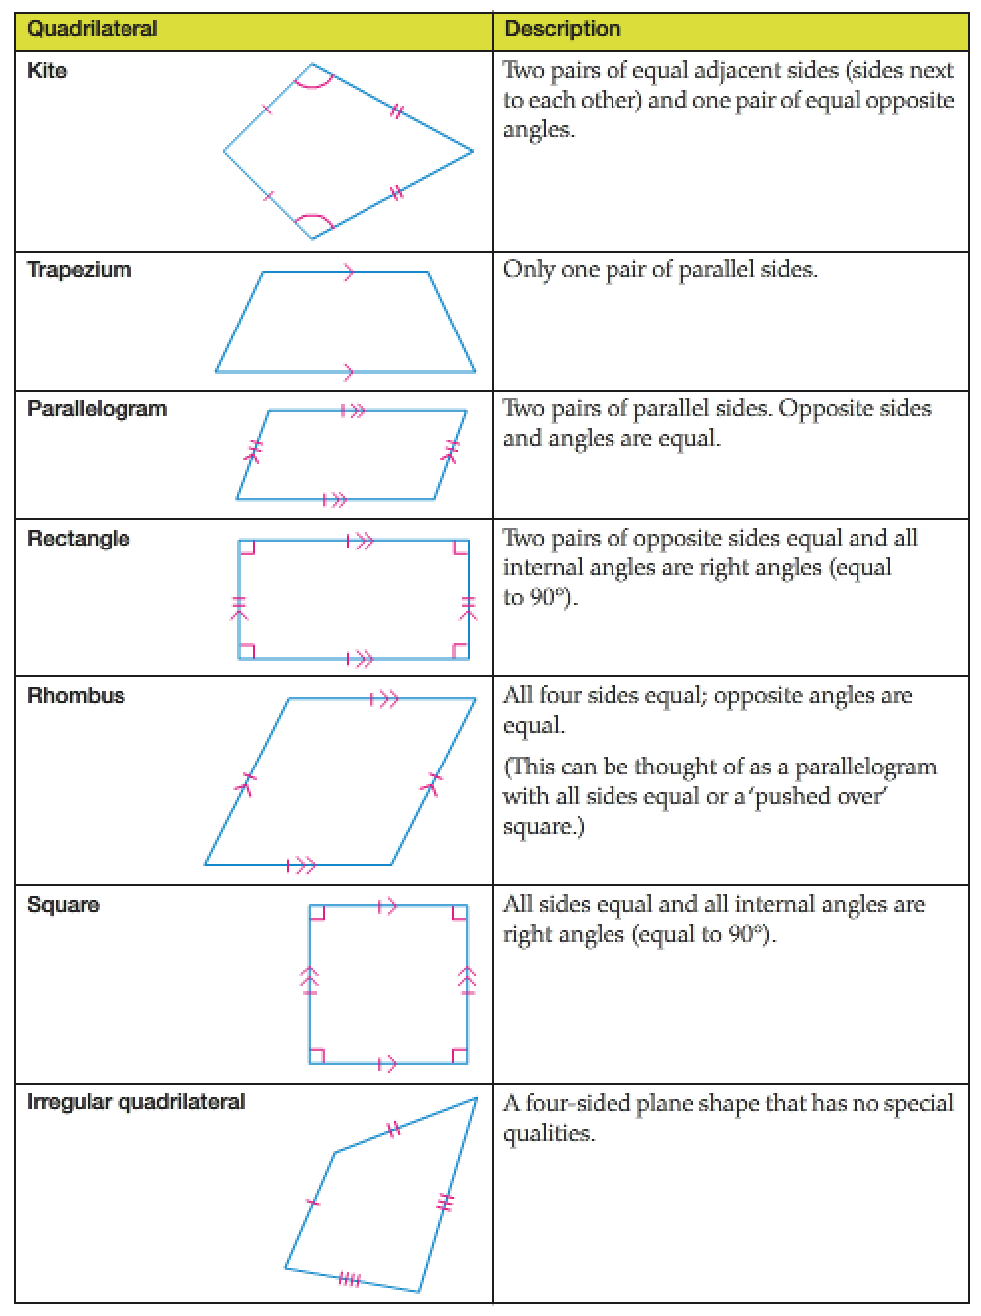
Daily Review

Slide 4
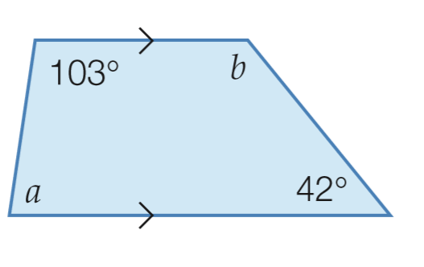
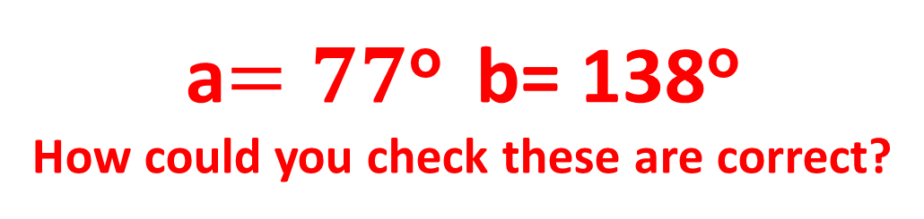
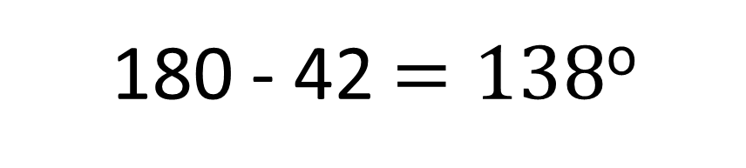

Daily Review
Transversal rules for parallel lines
Co-interior angles add up to 180 (C Rule)
Corresponding angles are equal (F Rule)
Alternate angles are equal (Z Rule)
$$103 and a are co−interior$$
$$180 −103=77$$
$$42 and b are co−interior angles$$
180 - 42 $=138\text{o}$
a$=77\text{o}$ b= 138$\text{o}$
How could you check these are correct?

Slide 5

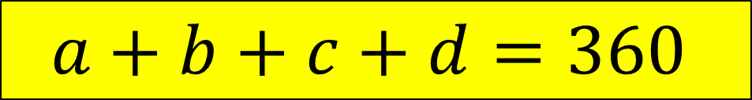

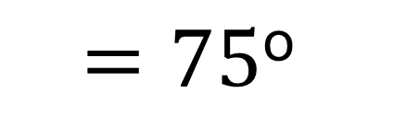

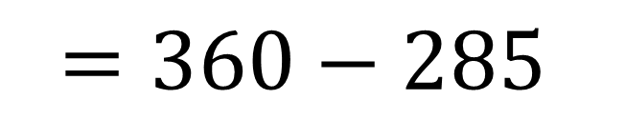

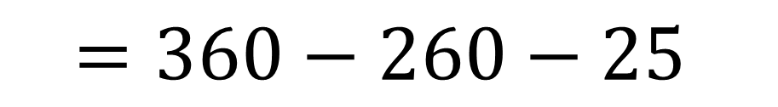

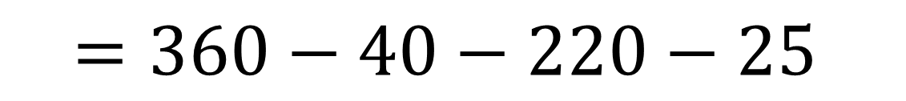
Daily Review
$$a+b+c+d=360$$
$$25\text{o}$$
$$d$$
$$d=360−a −b −c$$
$$22\text{0}\text{o}$$
$$=360−40−220−25$$
$$=360−260−25$$
$$40\text{o}$$
$$=360−285$$
$$=\text{75}\text{o}$$

Slide 6
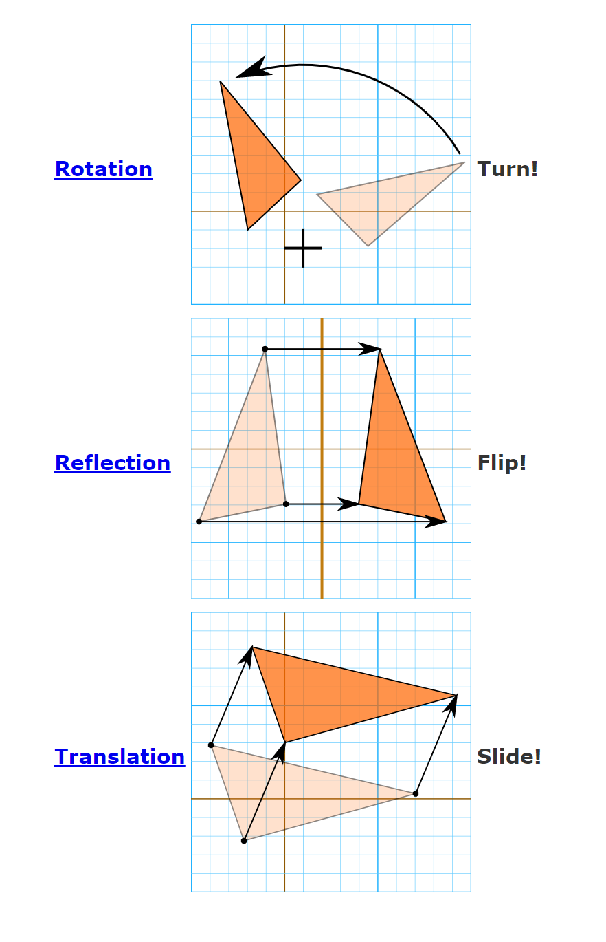
Daily Review
There are 3 transformations:

Slide 7
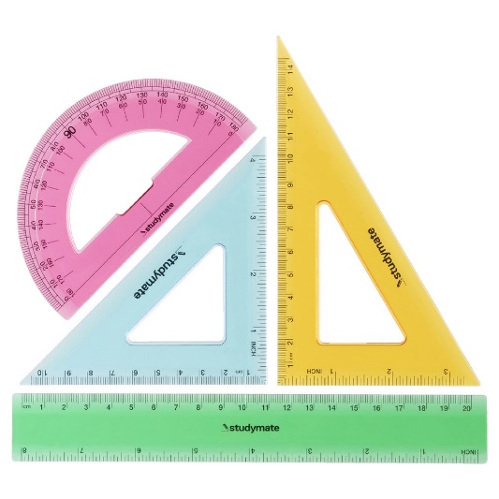

Learning Objective
CFU
What will we learn today?
CFU
I will name congruent shapes and identify congruent tests.
How will you know that you are successful?
Success Criteria
At the end of the lesson, I will be able to:
Define congruency.
Name congruent shapes.
Identify congruent tests (SSS, SAS, RHS, AAS)

Slide 8
Concept Development
Congruence
The transformations of translation, reflection and rotation all produce congruent shapes.
Congruent shapes are identical in both shape and size.
The symbol ≡ means ‘is congruent to’
A
F
E
These two triangles are exactly the same shape and size. Therefore they are congruent.
We can write this in a mathematical statement.
Δ ABC ≡ ΔDEF
B
C
D

Slide 9
Skill Development
Congruence
Congruent shapes are identical in both shape and size.
The symbol ≡ means ‘is congruent to’
Use mathematical statements to describe the congruent shapes below.
B
E
ΔABC ≡ ΔDEF
A
C
F
D
What type of transformation has occurred?

Slide 10
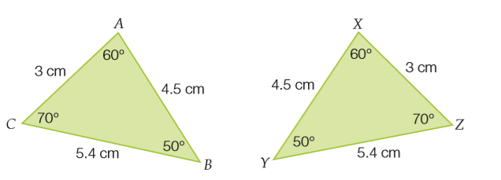
Congruent Triangles
Concept Development
Triangles that have matching sides of the same length and matching angles of the same size are known as congruent triangles
These triangles are congruent, all sides and angles are equal.
It is NOT necessary to know all sides and angles are equal to prove congruence

Slide 11
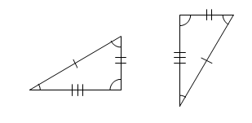
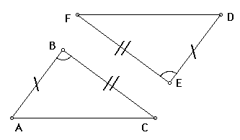
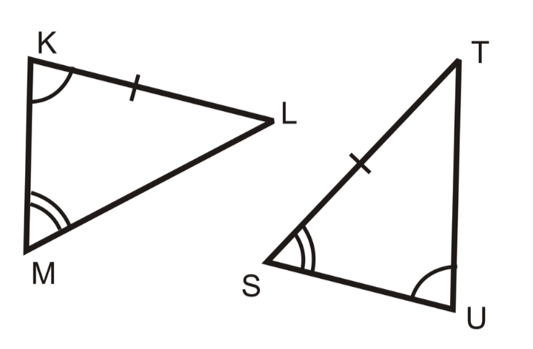
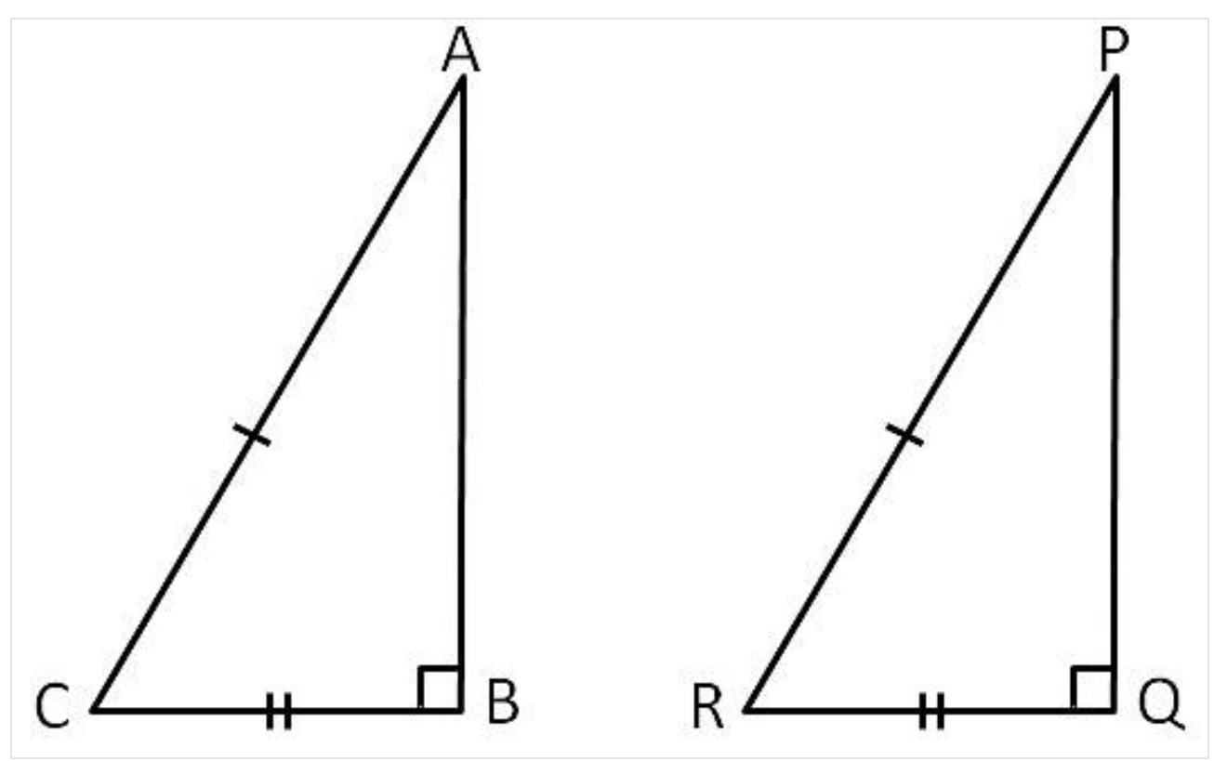
Congruent Triangles
Concept Development
There are four tests to determine if triangles are congruent. Each requires 3 pieces of information. They are:
Side, side, side (SSS) [3 sides match]
Side, angle, side (SAS) [2 sides and the angle in-between match]
Angle, angle, side (AAS) [2 angles and a side match]
Can also be ASA
Right angle, hypotenuse, side [a right angle, a side and the hypotenuse match – The hypotenuse is opposite the right angle]

Slide 12
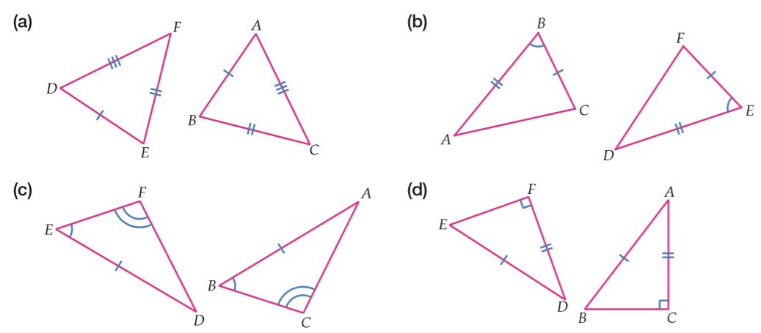
What test would you use to prove congruence? (SSS, SAS, AAS, RHS)
Concept Development
AAS
RHS
SAS

Slide 13
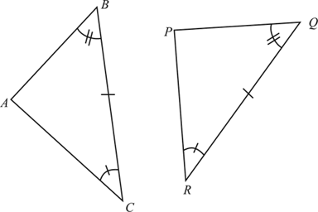
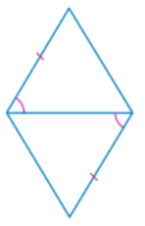
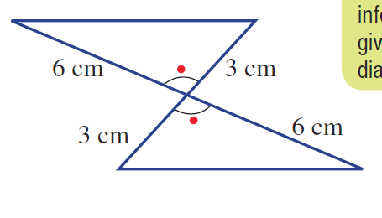
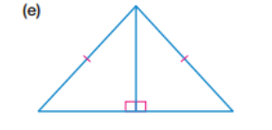
What test would you use to prove congruence? (SSS, SAS, AAS, RHS)
Guided Practice
ASA
RHS
SAS
SSS
SAS
RHS
SAS

Slide 14
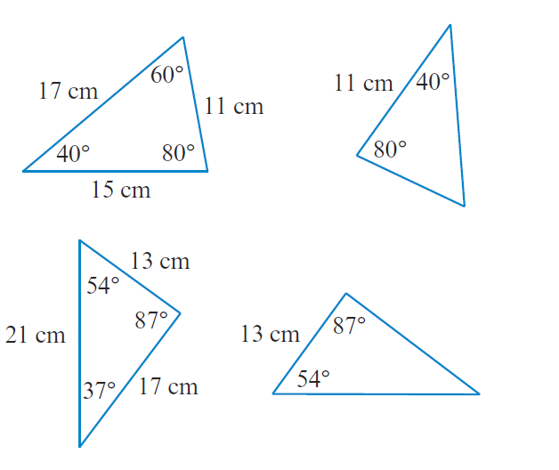
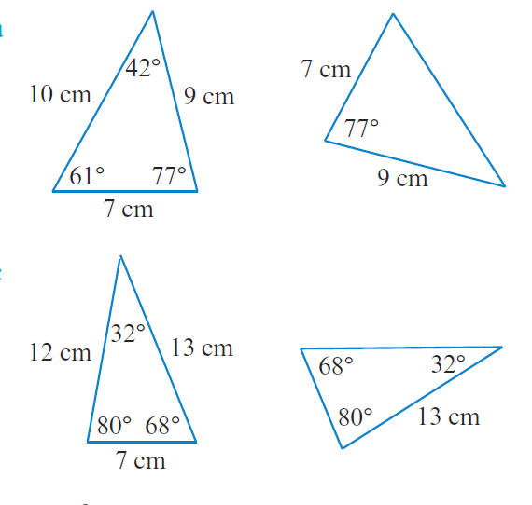
What test would you use to prove congruence? (SSS, SAS, AAS, RHS)
Guided Practice
Not congruent
SAS
ASA
Not congruent

Slide 15
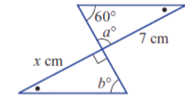
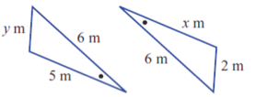
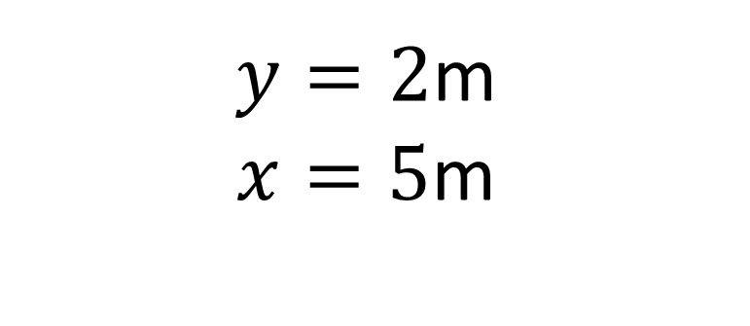

The following triangles are congruent. Find the missing angle/side.
Guided Practice
$y=2$m
$$x=5\text{m}$$
$$x=7\text{m}$$
$$y=90°\text{(}\text{vertically} \text{opposite}\text{)}$$
$$b=60°$$

Slide 16
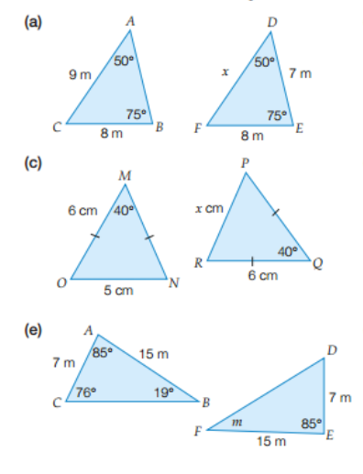



The following triangles are congruent. Find the missing angle/side.
Guided Practice
$$x=\text{9}\text{m}$$
$$x=\text{5}\text{c}\text{m}$$
$$m=\text{19}°$$

Slide 17
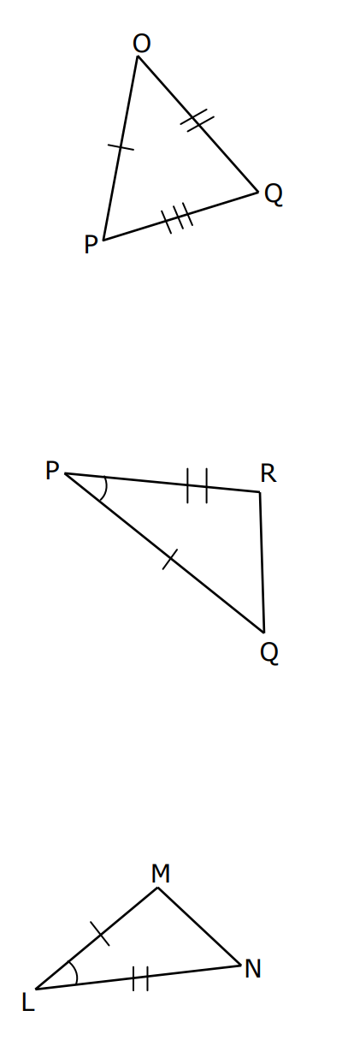
Which of these triangles are congruent? Write a congruence statement.
Concept Development
It is important to match vertices correctly
Δ QPR ≡ ΔMLN
Because of SAS
QP is the side with 1 dash, so that matches with ML.
P and L are the vertices with the angle given so it is the second letter we must write.
It then goes from the angle to the side with 2 dashes (R and N).
Where you start does not matter Δ PRQ ≡ ΔLNM is also true!

Slide 18
Before we said the reasons for these triangles to be congruent, now write the congruence statement.
Guided Practice
RHS
SAS
SSS
Δ ABC ≡ Δ FDE
Δ BCA ≡ Δ QRP
Δ ABC≡ Δ DEF

Slide 19
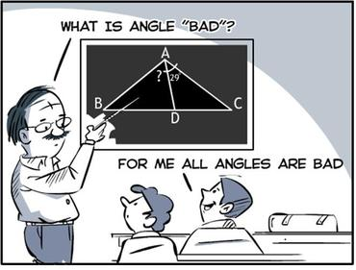
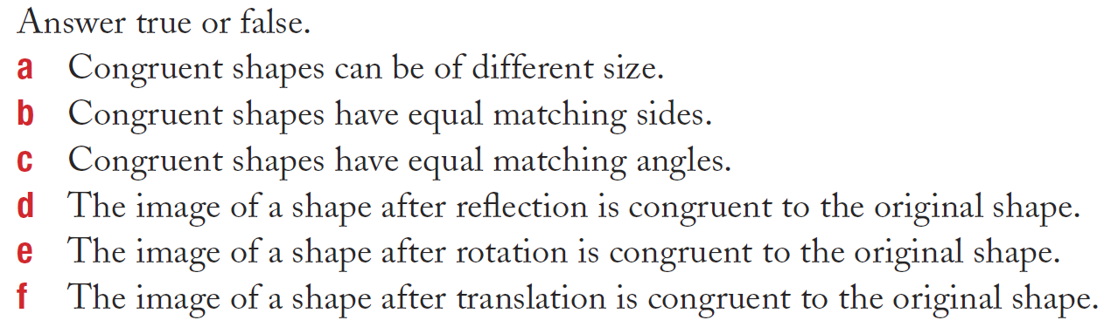
Skill Closure
What have we learnt today?
Lesson Objectives:
I will name congruent shapes, describe and write proofs for congruent triangles using congruence tests
F
T
T
T
T
T

